Slide 1
Organizing a state association
National Alternative Education Association
Organizing a State Association
Notes:
How to start a state association when nothing exists.

Slide 2
Why a state alternative education association?
Define Need and Purpose
Notes:
Alternative Education is one of the 15 effective strategies identified by NDPN/C to reduce drop-outs. In December of 2016 a small group of alternative educators and partners from Utah State University met together to determine the level of commitment to establish a Utah Alternative Education Association. The discussion focused on the lack of Utah Board of Education support or oversight of alternative education. Since there is no specific funding in Utah for alternative programs, the group determined that there was no one to provide specific professional learning, advocacy, or networking. The idea for a conference initiated and interest email invitations were sent to known alternative education programs and schools. The response was a resounding “YES, this is a needed opportunity.” Based on the positive response, I chose to use the organizing of alternative educators into an association beginning with a professional learning conference as my NDPS Field Project. The conference focus included drop-out prevention, drop-out intervention, professional learning for classroom teachers, advocacy needs and strategies, and professional networking.
Using the National Alternative Education Association as the model I organized a conference for professional learning and networking. I also organized an election process for a UAEA Board of Directors to be completed at the conference held on March 27, 2017.

Slide 3
Step 1 If Not YOU, then Who?
Host a discussion!
  Invite interested participants to discuss options to organize a state association of NAEA.
  Include state education department officials, district, school, university, and industry partners, and community partners.
  Establish a need.
  Keep a record of the initial meeting.
Notes:
No formal organization for alternative educators in Utah to network, review, and share best practice on drop-out prevention/intervention for at-risk students.
No specific professional learning for alternative educators and their partners who work with at-risk students as providers of drop-out intervention programs.
No oversight, budget, or accountability by any member of the Utah State Board of Education specific to alternative education to provide support for professional learning or advocacy for alternative education.

Slide 4
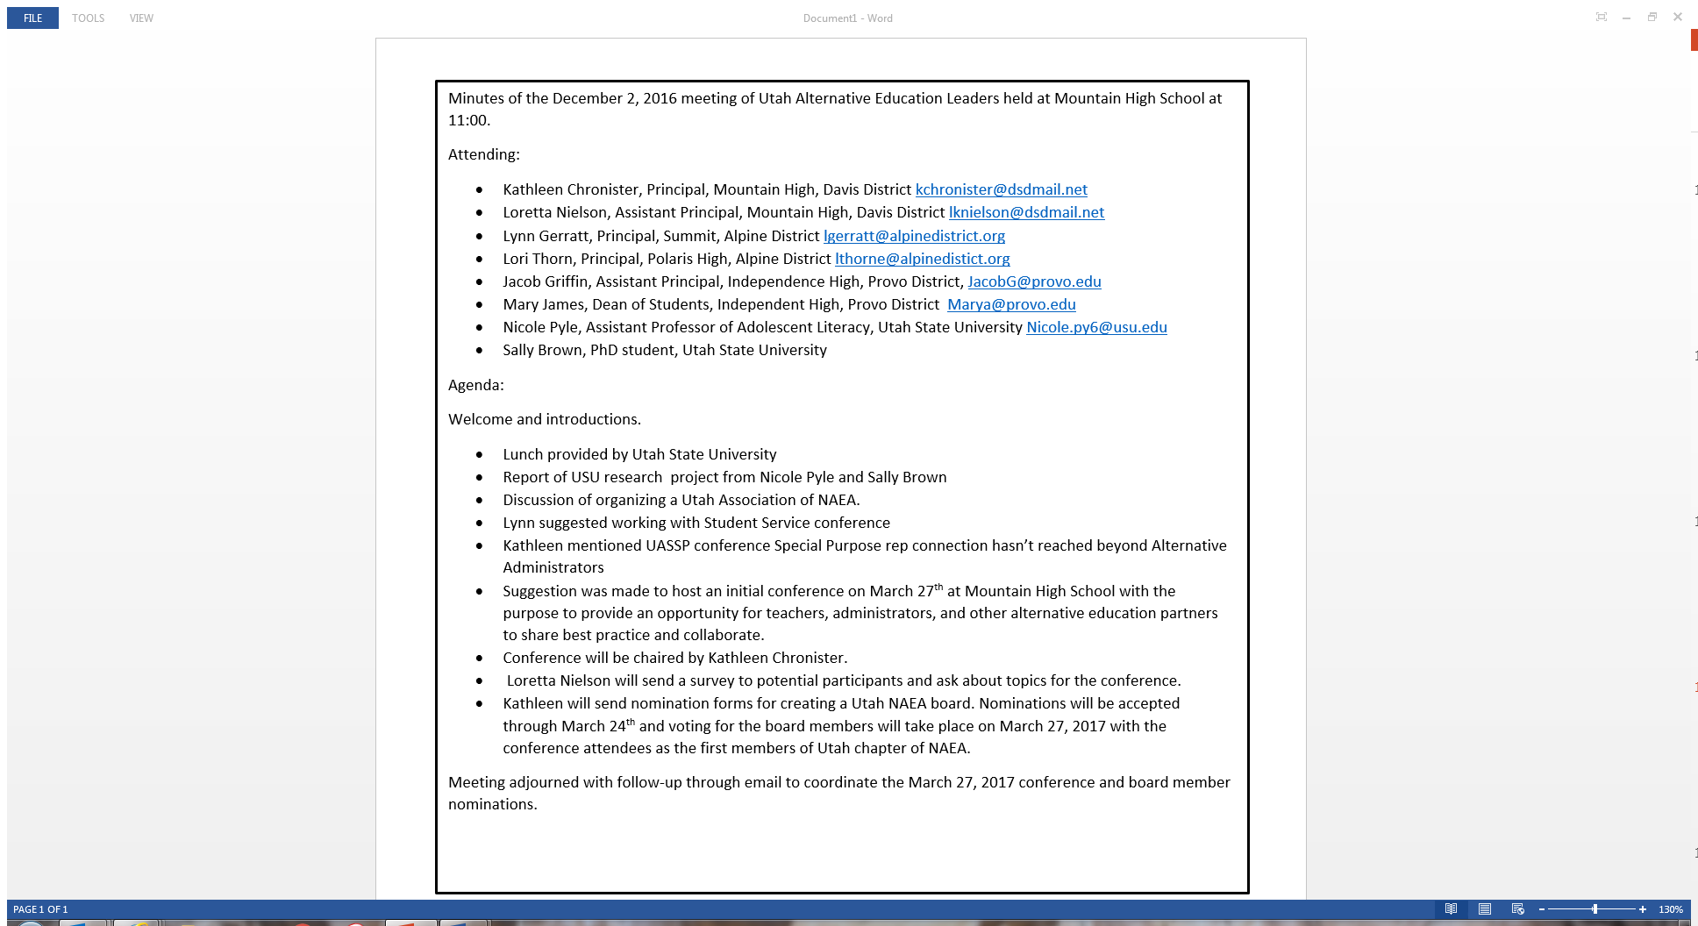
Step 2 Document
Minutes From Initial Meeting to Organize
Your Name HERE

Slide 5
Step 3 Beginning of a State Association
Host a meeting, conference, webinar, web site, email blast or some form of communication to invite potential members to join.
Enroll members.
Hold elections from the membership for board of directors.
Notes:
Create a Utah association to support and provide professional learning and advocacy for alternative education professionals and their partners who work with at-risk students.
Host an alternative education conference for Utah alternative education professionals.
Form a Board of Directors for the Utah Alternative Education Association.

Slide 6
Step 4 Establish the Role of Board of Directors
The (Your State) Alternative Education Association is forming a board for the purpose of:
Create a 501(c)3 non-profit organization for the state association with a board of directors including:
President
President-elect
Secretary
Treasurer
Past President
At-Large members
Specify criteria such as:
  Educators
  Partners who work with At-Risk Students
  Non-education partners
Standing committees appointed by the board of directors such as:
Conference Chair, Membership Chair, Webmaster, Social Media, etc.

Slide 7
Step 5 Election of Board of Directors
Create a ballot of the membership to vote for the board of directors.
All applicants for the board of directors need to sign Conflict of Interest Disclosure.
Hold an election for the membership to vote for the board of directors.
Announce the board of directors and create:
  Letter head with the name of the association
  Logo to identify the association
  Web site
  Membership roster

Slide 8
Step 6 Begin the 501(c)3 Application
MUST HAVE THE FOLLOWING TO BEGIN THE 501(c)3 Application
Mission and Vision Statements.
By-Laws.
Define Roles and Responsibilities of the Board of Directors.
Apply for an EIN to begin the process of 501(c)3 status.
Treasurer and 1 board member needed to open a banking account.

Slide 9
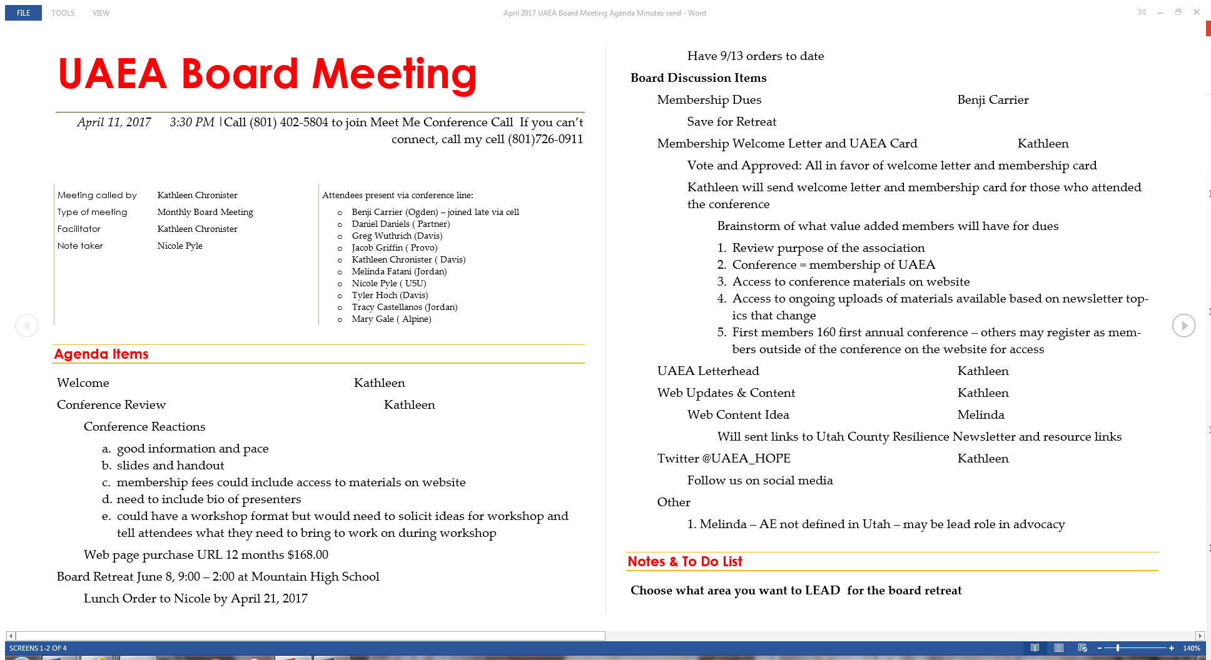
Step 7 Hold 1st Board Meeting
Keep minutes of the meeting.
YOUR

Slide 10
Step 8 Create Your Association Mission and Vision Statements
EXAMPLE
Mission: The YOUR STATE Alternative Education Association (YOUR STATE) provides advocacy and support for professionals who work on behalf of children and youth receiving alternative education services in YOUR STATE.
Vision: The vision of YOUR STATE is two-fold.
1. To provide opportunities for alternative education professionals and their partners to network, collaborate, and participate in professional learning specific to research and best practices in alternative education.
2. To provide a unified voice of advocacy for students in alternative schools and programs in YOUR STATE to promote understanding and support from school districts, charters, YOUR State Board of Education, and policymakers.

Slide 11
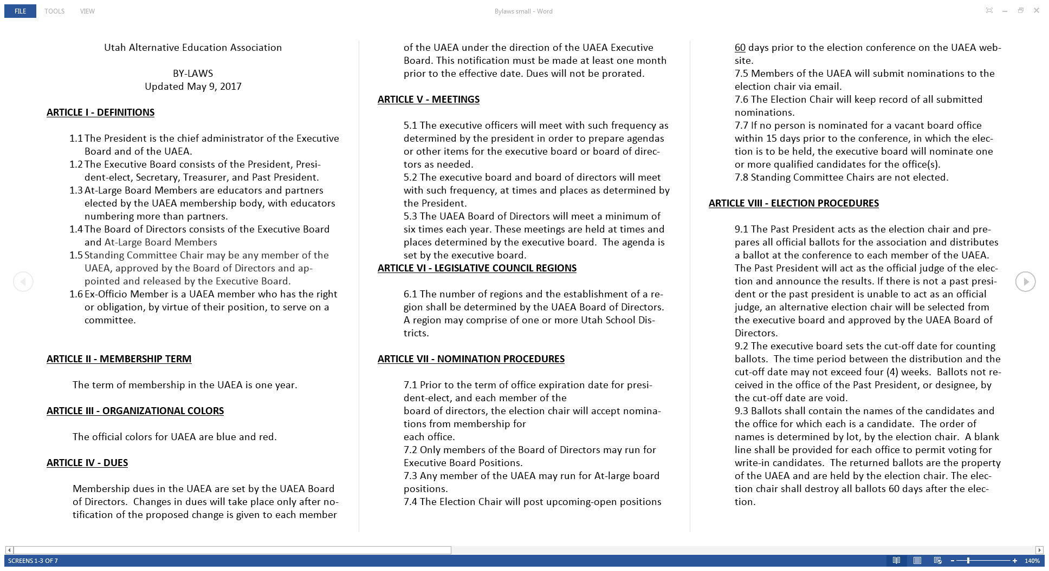
Step 9 Create and Vote on your Association By-Laws
EXAMPLE
Your State Association
Links to By-Law Examples
Arizona Alternative Education Consortium
http://www.azaec.org/who-we-are/bylaw/
Arkansas Association of Alternative Educators
http://arkaltedu.org/wp-content/uploads/2017/08/AAAE-CONSTITUTION-AND-BY-LAWS-July-2017.pdf
Minnesota Association of Alternative Programs
http://www.maapmn.org/images/AboutUs/BylawchangesFINALFeb2011-1.pdf

Slide 12
Step 10 Locate Information for Incorporating a Nonprofit Corporation in Your State
Start with the Department of Commerce web site.
Division of corporations and commercial code.
Follow the specific state requirements.

Slide 13
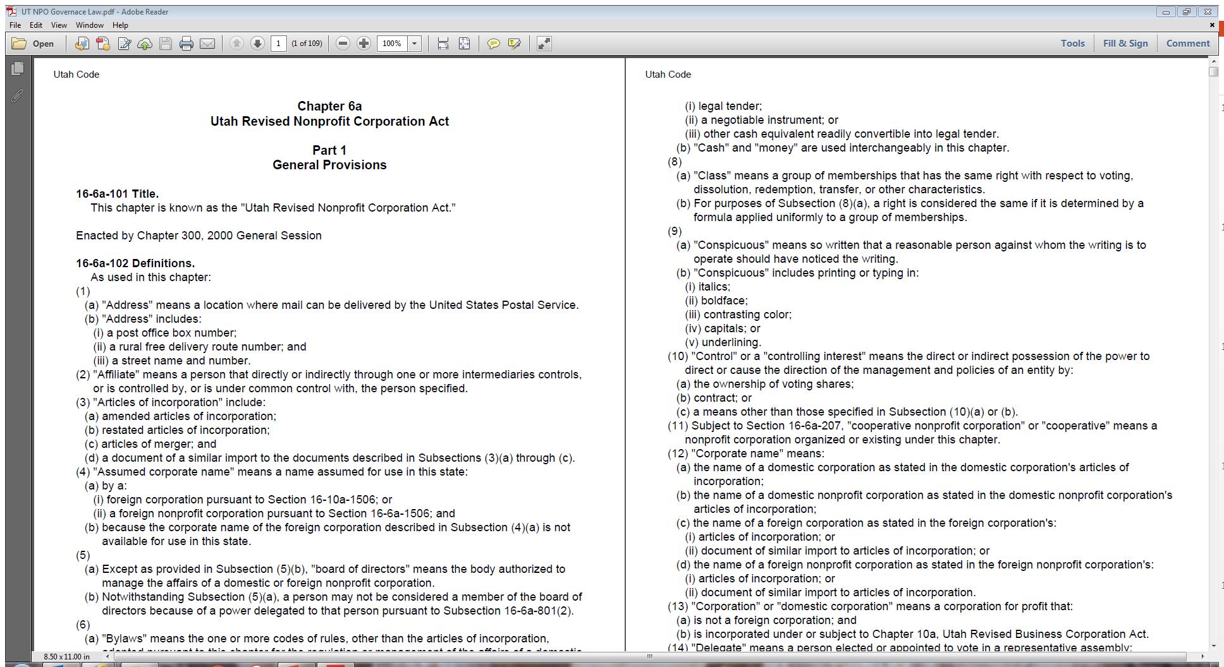
Step 11 Research Your State Requirements for Nonprofit Corporation Status
EXAMPLE
Your State

Slide 14
General Guidelines
The name of the corporation.
The business purpose or purposes of organizing the corporations, including important language required by the IRS for federal tax exemption.
A statement declaring whether or not the corporation will have "voting members."
The number of directors constituting the initial governing board [at least three (3)] and may list the name of each of those directors (optional with Articles until first annual report).
The street address of the business entity’s initial registered office and the name of its initial registered agent at such address.
The name, street addresses and verified signatures of each incorporator (at least one).
The street address for the principal office (optional with Articles until first annual report).

Slide 15
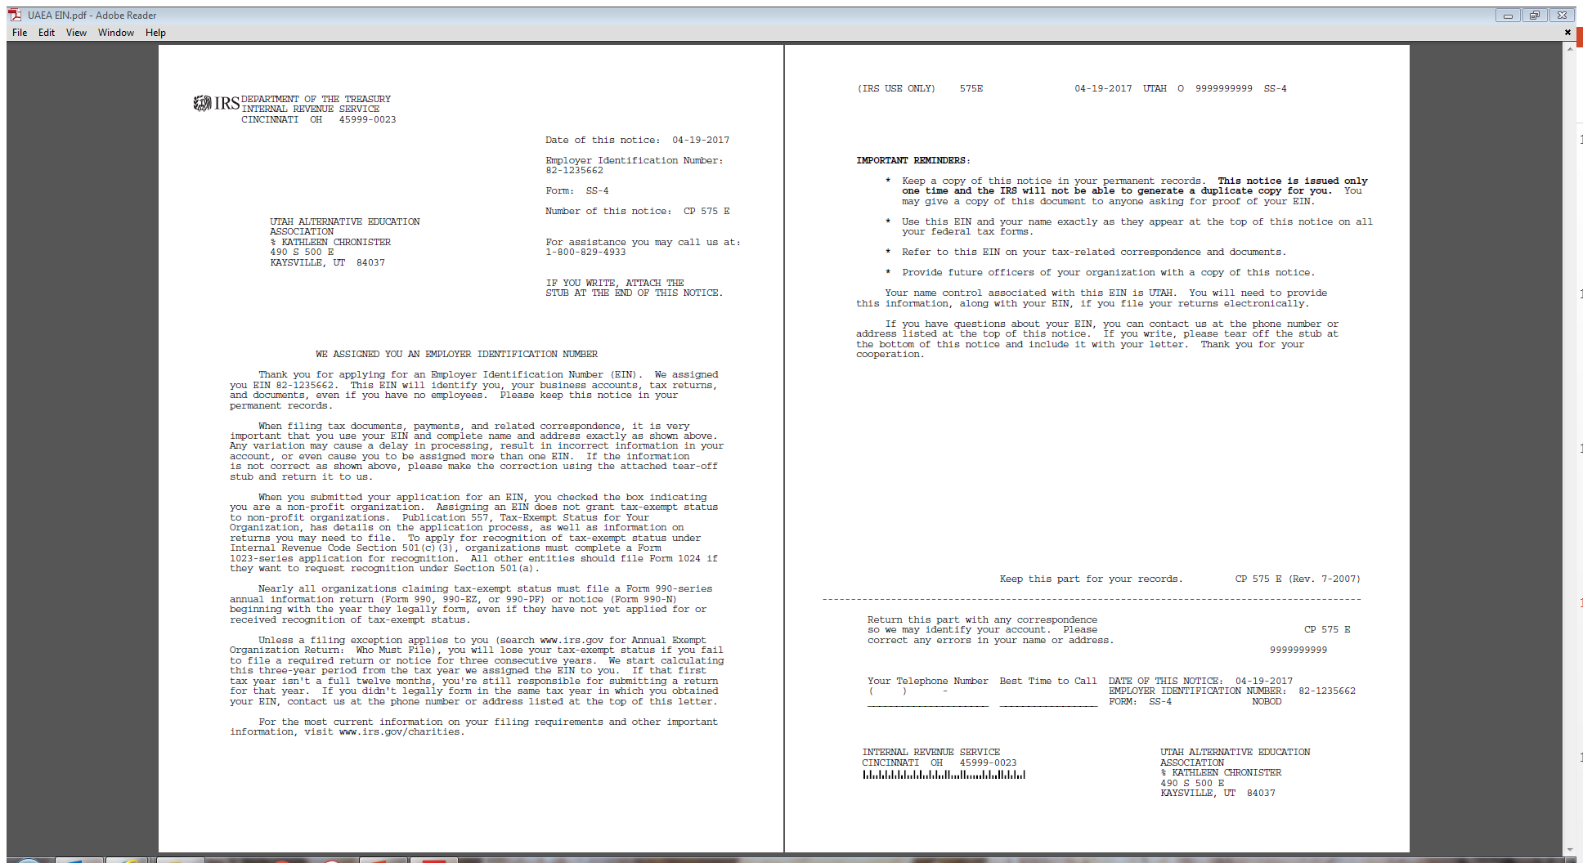
Step 12 Apply for an Employer Identification Number (EIN) from the IRS
Your Association Information listed here on the EIN from the IRS.

Slide 16
Congratulations
You’re on your way…

Slide 17
Now you need $$ to begin the 501(c)3 application and NAEA is willing to help!
Complete the NAEA Application for State Association Start-up Cost Reimbursement and attach all required documents.
Attach copies of:
  Minutes of initial board meeting.
  Mission and Vision statements.
  Association by-laws.
  EIN approval letter.
  Name and address to document and mail the $500.00 start-up grant.

